Slide 1




Hello, Next Gen!
Gallery of many beautiful designs
Structured and organized content
Responsive, mobile-first design
1
Notes:
-----[Duration]-----
1 minute
-----[Content]-----
Hello again and welcome to episode 4 of the Hello, Next Gen lunch and learn series! Let’s just start out with a little refresher. In the first series we talked about the three pillars that make Next Gen an outstanding user experience, while keeping dealers relevant.
A gallery of many beautiful designs - helps dealers differentiate themselves and connect with the customer. Their website should be an extension of the image they portray in their physical dealership.
Structured and organized content – which makes publishing, editing and reusing content easier. It also means better results in the search engines.
Responsive design designed mobile first – gives consumers the experience they’re expecting, regardless of whether they’re on a desktop or mobile device.
These last two pillars – structured content and responsive design – these really directly impact our Next Gen sites’ search engine optimization, which is what our conversation today is centered around.

Slide 2
Hello, Next Gen!
The SEO Message
Why do you need strong SEO?
  Next Gen and SEO
  Demo
Dealer hurts
Notes:
-----[Duration]-----
1 minute
-----[Content]-----
SEO is one of those terms we hear a lot – it makes a lot of sense in theory (better search engine optimization means your site shows up higher in the search results). But what specifically about our Next Gen sites makes that happen? And what exactly does strong website SEO do? Why is it so critical for our dealers’ business? We’re going to get into all that today, and we’ll take a look at some of the Next Gen features that help us accomplish solid search results.

Slide 3



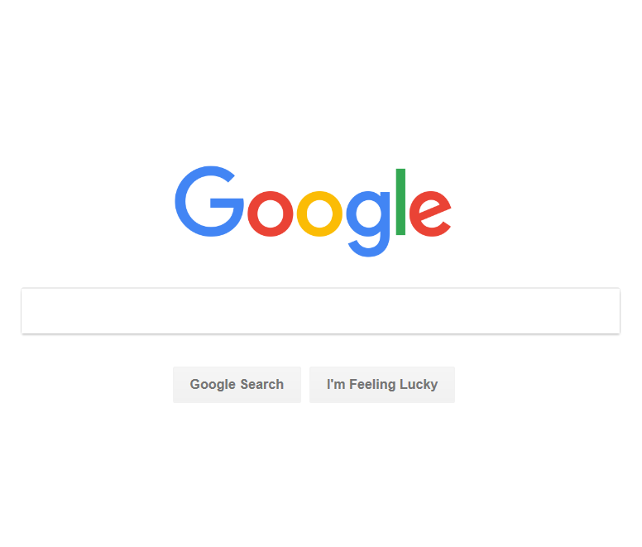
  25%MORE
  indexed pages
  3x BETTER
  Google recognition
Notes:
-----[Duration]-----
1 minute
-----[Content]-----
Just to give you an idea what Next Gen can do in terms of SEO… Our Next Gen Websites give you 25% more indexed pages, and 3x better content recognition by Google. 1.2 trillion global searches are being conducted every year, and of those 91% of people are using organic searches. How your website ranks on search engines like Google and Bing will directly affect how much business you get through online traffic. Throughout this series, we’ve zeroed in on a couple key points that make Next Gen a standout choice for dealers:
Keeping the dealer relevant throughout the consumer’s vehicle purchase lifecycle
Connecting with consumers in the ways they want to engage.
With more indexed pages and better Google recognition, Next Gen is capturing consumers early on in the car buying process and getting them engaged with the dealer’s website.

Slide 4




indexed pages
content recognition
why do
you need
strong SEO?
TRAFFIC
Notes:
-----[Duration]-----
1 minute
-----[Content]-----
Why should dealers care about these numbers? Well, by implementing strong SEO, you’re essentially driving more traffic to your site.
As we just mentioned, Next Gen gives you 25% more indexed pages. The more built-in structured data your site has, the better site indexing is by search engines. Site indexing means the content has been deemed good quality by the search engines and so they’re added to the searchable index. We’ll get into this a bit more later.
Not only that, but we also have 3x better content recognition by Google. How does that happen? Well, as you know all our pages are responsive, and therefore all our pages are mobile-friendly, which is actually an element that’s prioritized by Google. And better content recognition by Google basically means users are more likely to get to your site high up in their search results. With 60% of users initiating the car buying process online…it’s vital that dealers put their best effort forward in capturing relevant search traffic.

Slide 5

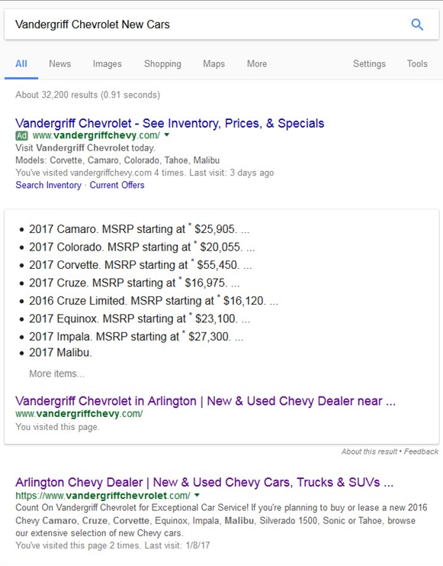
why do
you need
strong SEO?
structured content
answer box results
Notes:
-----[Duration]-----
2 minutes
-----[Notes]-----
Source: http://www.dealermarketing.com/how-your-dealership-can-take-control-of-the-google-answer-box/
-----[Content]-----
One of Google’s main goals is to anticipate the answers to our questions and provide us with the information that answers those questions right in the search results. Part of that solution is what’s known as the answer box content. Over time, this function has evolved and now has the ability to show dealership specific information, based on the website’s content structure. For example, it might pull up the dealership’s hours of operation, or even inventory and pricing. It reads the structured data coding from the website platform and displays the results in the answer box, removing even the added step of a user finding your site in the search results. Now consider if your dealer’s site doesn’t have this built-in structure…if that’s the case, Google may pick content from another competitor’s site, or try to piece together the info which can end up being incorrect.

Slide 6



SEO terms
spiders
title tags
meta tags
header tags
page rank
meta tags: an HTML element used to describe the information on the page
header tags: HTML markup used to distinguish headings and subheadings within your content from other types of text
title tags: an HTML element that specifies the title of a web page
spiders: software that browses the web and sends the data back to the search engine so they can index and rank the site
page rank: Google’s algorithm for estimating the importance of a given website
page rank: Google’s algorithm for estimating the importance of a given website
Notes:
-----[Duration]-----
2 minutes
-----[Notes]-----
Click to reveal description for each term.
-----[Content]-----
Before we get into a demo of how Next Gen utilizes SEO, let’s do a quick review of some basic terms you’ll hear me refer to.
Spiders (also known as crawler, bot, robot) – a search engine spider is a special piece of software that browses the web, looks for new sites, checks what’s going on them and sends the data back to the search engine so they can index and rank the site
Title tags - A title tag is an HTML element that specifies the title of a web page. Title tags are displayed on search engine results pages (SERPs) as the clickable headline for a given result, and are important for usability, SEO, and social sharing. Every page has a title tag. From a user’s standpoint the title tag is visible only in one place – your browser’s title bar. Although a seemingly small detail, it’s actually a pretty important SEO factor. There’s no better way for search engines to find out what the page is about than by looking at the title tag.
Meta tags - Meta elements are typically used to specify page description, keywords, author of the document, last modified, and other metadata. Meta tags consist of two main elements: meta description, and meta keywords. Meta tags are placed in the HEAD section of the HTML structure of your page. The information contained in those tags is usually not meant for the users but for the search engines. It helps them determine what the page is about.
Header tags – This is HTML markup used to distinguish headings and subheadings within your content from other types of text.
PageRank or PR is an algorithm first created by Larry Page (one of two founding fathers of Google) to estimate the importance of a given website. No one is 100% certain about how it actually works or what all the factors are because Google is not very open in that matter. Pages with the highest PageRanks are usually ones that are highly recognizable and popular around the internet. For example, Google.com itself has a PR of 10. Facebook is PR9 website. Yahoo – PR9.

Slide 7

DEMO
DEMO
Notes:
-----[Duration]-----
10 minutes
-----[Notes]----
Jump out to WSM – SEO tab: http://websites.cobalt.com/wsm/index.do
Walk through some of the analytics on SEO Performance page
Organic Search BI Insights
Historical Keyword Ranking
SEO Keyword Rankings
Demo Meta Editor – explain how key words, titles, meta descriptions are used
Demo Next Gen’s tools for setting page expiration dates, categories, and tags
Show how structured content is used to update
-----[Content]-----

Slide 8

structured content in SEO
TWO WEEKS
secondary Next Gen site
primary dealer.com site
Notes:
-----[Duration]-----
2 minutes
-----[Content]-----
So I just showed you how our structured content in Next Gen contributes to outstanding SEO. But let’s take that a step further and make it real. This is an actual example where the dealer already had a primary dealer.com site, and we created a secondary Next Gen site for them. After two weeks on Next Gen (without any additional SEO modifications to what comes “out of the box”), the Next Gen site came up higher in the search rankings than their primary dealer.com site. We don’t know what kind of SEO work has been done on the dealer.com site but regardless, we’re ranking higher due to the way the site is built and the type of content that lives on it. Notice also, the answer box pulled inventory content directly from the Next Gen site.

Slide 9







responsive
current
information
Next Gen
+ SEO
speed
indexed
pages
structured
content
Notes:
-----[Duration]-----
2 minutes
-----[Content]-----
Next Gen and SEO
Ok, so let’s take a moment and just summarize the points that make Next Gen’s SEO so great.
Great SEO and faster site performance result from a structured content foundation. Shoppers will be able to easily find the dealer’s sit quickly thanks to prominent placements in organic web searches.
Next Gen websites have several built-in features that help drive better indexing on search engines that help dealers rank high in key word search results:
All pages are responsive, and therefore are mobile-friendly, which is an element that’s prioritized by Google. Google has stated that responsive design is its preferred mobile set up (as opposed to adaptive design or having a separate mobile site). Google has incorporated updates to their algorithm that improves rankings for sites that provide a mobile-friendly experience.
We’re faster: Our Next Gen site load speeds are 2x faster, which is also rewarded in the search rankings.
Next Gen has new tools for setting page expiration dates, categories, and tags, making it so only the most current information is visible in search engines, and as we’ve talked about, relevant information is perceived as better information by the search engines.
Structured content. With Next Gen, you’ve got built-in structured data, which means better site indexing by search engines. Also, structured content enables dealers to load content once and then easily distribute it to multiple sites and pages, again helping to keep information accurate and current. And let’s not forgot what we talked about earlier – well structured content directly affects the answer box content results in Google.
We have more informative Vehicle Search Results pages that drive better customer interactions.
And last but not least, we’ve got an increased volume of indexed pages – 25% more to be exact

Slide 10

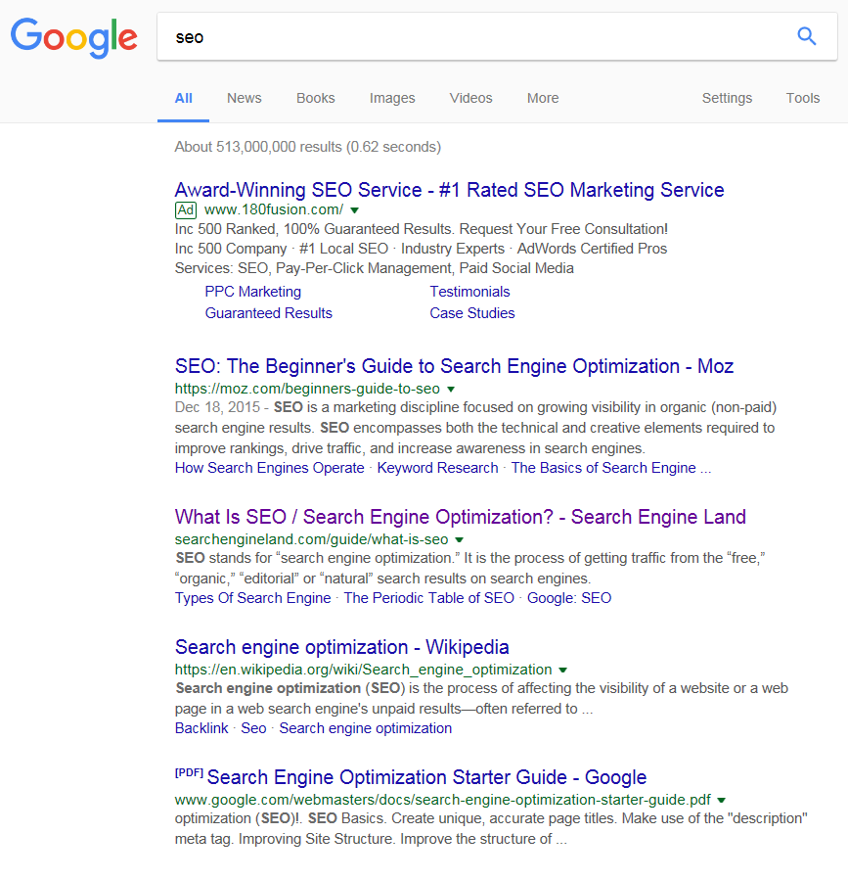
#1 listing receives 33%
of traffic
33%
18%
11%
8%
Notes:
-----[Duration]-----
2 minutes
-----[Notes]-----
Source: https://searchenginewatch.com/sew/study/2276184/no-1-position-in-google-gets-33-of-search-traffic-study
-----[Content]-----
Dealer Hurts
In our past sessions, we’ve talked about how responsive design helps meet the consumer’s changing expectations. But what good does that do, if they can’t even get to the dealer’s site? Next Gen helps dealers provide a better consumer experience, keeping them relevant in today’s market, by getting them to the dealer’s site quicker and more directly. Dealers can’t afford to be second or third in the search results. The top listing in Google’s organic search results receive 33% of the traffic, compared to 18% for the second position, and it only gets worse from there. And as the saying goes…the best place to hide a dead body is on the second page of a Google search! With 1.2 trillion global searches are being conducted every year, dealers cannot afford to give up 15% or more of web traffic to their competitors. Dealers will directly benefit with more leads when their site is coming up high in the search results.

Slide 11

  What can you do with this information?
value of
strong
SEO
    better search ranking
    more Internet traffic
    keeping dealers relevant
Notes:
-----[Duration]-----
1 minute
-----[Content]-----
So what can you do with all this information?
Keep the conversation focused on the value of strong SEO – help your dealers understand the importance of SEO in better connecting to their customers; and keeping them relevant in the consumer purchase process. SEO opens the doors to more Web traffic, and ultimately more leads.
Next time we meet we’ll be looking at Next Gen’s VSR and VDP options, and how our inventory pages make for an improved consumer experience.
Thank you very much and see you next time!

Slide 12
Notes:
-----[Duration]-----
2 minutes

