Slide 1




Hello, Next Gen!
Gallery of many beautiful designs
Structured and organized content
Responsive, mobile-first design
1
Notes:
-----[Duration]-----
1 minute
-----[Content]-----
Hello again and welcome to episode 6 of the Hello, Next Gen lunch and learn series! As always, let’s just kick off with a quick review of those three pillars we’ve identified as the main value points of Next Gen.
A gallery of many beautiful designs - helps dealers differentiate themselves and connect with the customer. Their website should be an extension of the image they portray in their physical dealership.
Structured and organized content – which makes publishing, editing and reusing content easier. It also means better results in the search engines.
Responsive design designed mobile first – gives consumers the experience they’re expecting, regardless of whether they’re on a desktop or mobile device.
Today, we’ll hit on all of this a bit as we talk Personalization and how it affects the consumer experience, and their engagement with the dealer’s site.

Slide 2
Hello, Next Gen!
  The Message
  The Proof
    Engagement Map
    Analytics
  Demo
  Takeaways
Notes:
-----[Duration]-----
1 minute
-----[Content]-----
So, why are we here to day? We’re finally going to dig into personalization and why it matters for the dealer and consumers. We’ll talk about how you can give dealers the proof their look for, through our engagement map and analytics…and we’ll do that by going through some detailed demoing, so you will be armed and ready to have this conversation with your dealers.

Slide 3



view 53% more
INVENTORY
personalized
content
perform 60% more
VEHICLE SEARCHES
Notes:
-----[Duration]-----
1 minute
-----[Notes]-----
-----[Content]-----
Targeted messaging and automated changes to your content keeps consumers on your site longer. Shoppers who received a personalized site are twice as likely to return to that site.
If that’s reason enough, shoppers who receive a personalized experience view 53% more inventory and perform 60% more general vehicle searches.
Simply put, personalization makes shoppers into buyers. Because people are so used to easily finding what they want online on their favorite shopping sites, CDK can help dealers offer a more personalized experience, making customers more likely to return to their site. They will view more while there, and they will take the actions that you want them to take.

Slide 4

The message
connect with CUSTOMERS
pricing
inventory
sales process
consumer behavior
PERSONALIZATION
Notes:
-----[Duration]-----
2 minutes
-----[Notes]-----
Good opportunity to reset expectations.
-----[Content]-----
When we first launched Personalization, we let dealers know that this would increase their bottom line—which they equate to sales. However, if you’re looking to this as a measure of success, then then it’s really going to depend on dealer inventory selection, pricing strategy, and sales process to carry the consumer across the finish line to a sale. Even when it comes to lead conversion, we’re still dependent on inventory, pricing, and ever changing consumer behaviors online.
Here’s a prime example (pun TOTALLY intended). Because Amazon personalizes it doesn’t make you necessarily buy, but it makes you stay on that site and look at more stuff. Conversion depends on Selection, Pricing, Promotions
Personalization is effective. As you know, it shows the consumer relevant vehicle information based on their shopping history. Personalization reduces clicks and drives engagement: more VDP Views per visit, more Inventory Searches per visit.
A better way to position Personalization is that the goal is to get shoppers looking at cars as quickly as possible. This technology accomplishes just that. Can we prove it? Yes, there are a couple of ways within DCC to prove to a dealer that Personalization increases engagement.

Slide 5
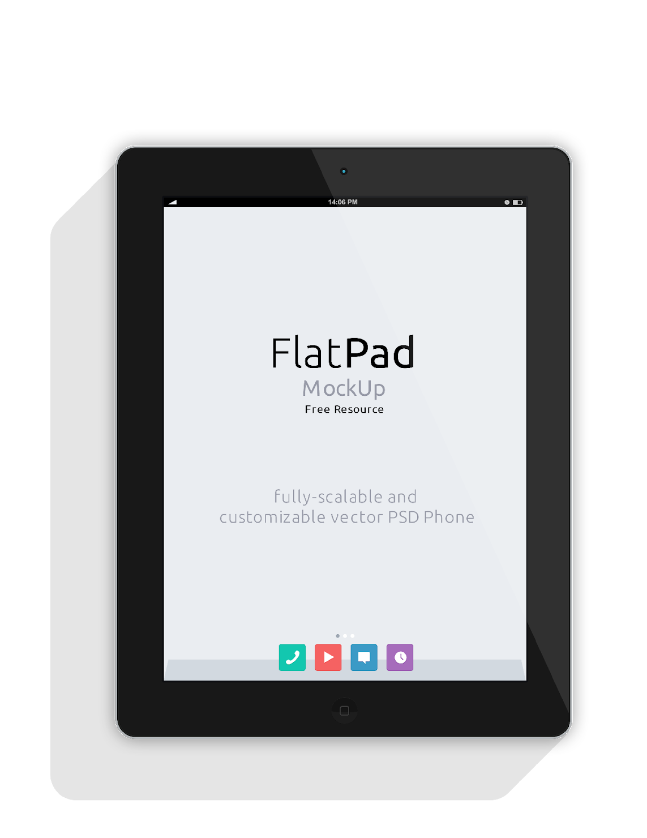

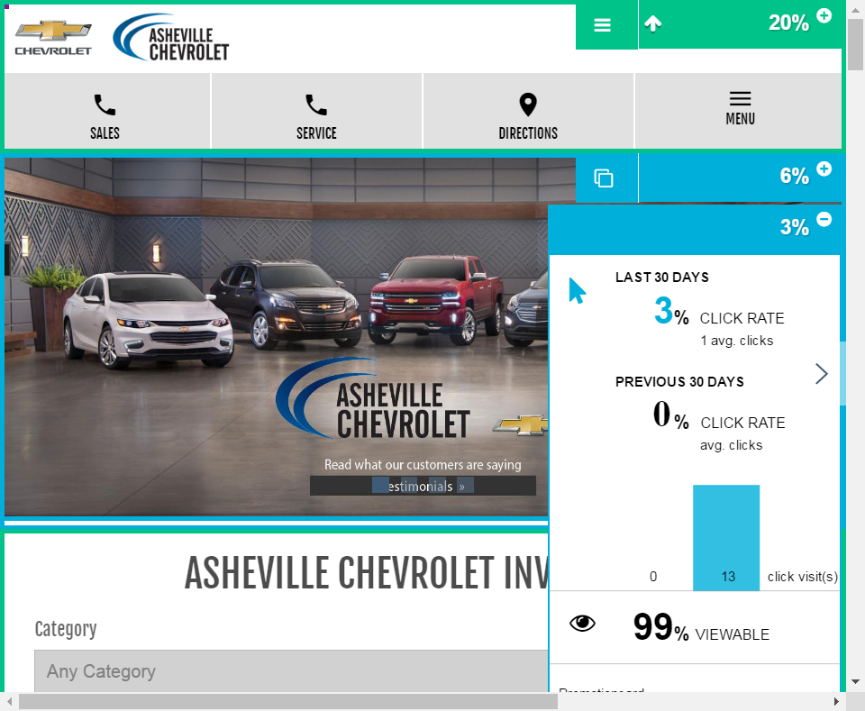

A
engagement
map
Notes:
-----[Duration]-----
2 minutes
-----[Notes]-----
Use: gmps-asheville (looking for a better site)
-----[Content]-----
One of the ways that we can prove that personalization drives more engagement is through the Engagement Map (duh!) The engagement map shows you in detail how much users are engagement with each piece of the website, even down to each of the individual hero slides.
--- Demo: DCC > Website > Engagement (Map) ---
When you first log into the Engagement Map, it shows engagement on the homepage (clicks, hover, and viewable). Check out the engagement of the widgets. A new enhancement also shows engagement for each hero slide. This is a deeper dive than the overall or average engagement it used to show.
---Demo: show slide deep dive by clicking on the pages icon.---
Pay attention to these numbers. Now I’ll change the experience. Demo: Change experience to a model. Silverado seems to work well. Show engagement numbers on the personalized widgets. Drill down on the hero again and show increased engagement with slides that match the vehicle profile/experience. Remember to switch between clicks and hover time permitting.
Using the Engagement map is a quick way to prove that consumers that get a website experience that matches their shopping history or profile

Slide 6

DEMO
DEMO
Notes:
-----[Duration]-----
2 minutes
-----[Notes]-----
Use: gmps-Asheville (looking for a better webID)
-----[Content]-----
But wait, there’s more! Is there a report in Analytics that tells the Personalization story the best? Absolutely.
--- Demo: Jump to Analytics > Audience > Audience Summary. Hover over the bars to see #s. ---
This is the report in Analytics that best demonstrates increased engagement because of personalized experiences. The default report shows VDP views per visit across all experiences…so average…rolled up…aggregate.
You can also drill down by specific experiences. Try drilling down by model.
--- Demo: In the Audience Summary report, select a model experience from the upper left drop down. ---
The proof is right here, and it isn’t aggregate data across the OEM program or our entire website platform. This is individual dealer performance. (Remind class not to show a dealer other dealer’s stuff. Only show them their own website performance)
So if a dealer asks you to show them what the site looks like for a Silverado shopper—they’re asking for a demo of Personalization on the site. Do it this way (go to next slide)

Slide 7
DEMO
DEMO
Notes:
-----[Duration]-----
2 minutes
-----[Content]----
Many of you demo Personalization by opening an incognito (no cookie/history tab or window) session in Chrome (or other browser equivalents). This isn’t the best way to demo personalization because it takes time to stage this. Also, you might be carrying history/cookies if you haven’t really closed your browser sessions. Bottom line, you can’t depend on incognito to really give you a cookie/history free session. This will mess with the personalization demo.
When you demonstrate the consumer experience, use the Preview Toolbar instead. It is faster and much more dependable.
TALK TRACK: The Preview Toolbar is the best way to:
See what is in your Profile and why certain models are being shown
Clear your Profile of all data to get a clean experience
Immediately see what is most shopped on a dealer site
Via the dropdown to the left of [MY PROFILE]
Modify your profile to force a specific experience quickly and easily
Select an audience in the dropdown to the left of [MY PROFILE]
Log in to the Preview Toolbar (incognito windows are not reliable to demo personalization)
Scroll to bottom of the page
Click “Dealer Log In”
Log in using CDK credentials
After page auto-reloads, click “MY PROFILE” and “CLEAR MY PROFILE”
Point out the non-personalized home page
Generic Hero Rotator
Non-refined search
Non-specific incentives
Non-specific model carousel
“MY PROFILE” with no model information
TALK TRACK: Shoppers have to click through multiple parts of the page even to start shopping.
Click through the rotator, carousel or any other widget
Go into inventory search and click through each of the filters just to get to the car they are looking for
Clicks, clicks, clicks
Just like every other dealer website, even dealers of the same make in your market
Go to Edmunds and search for the appropriate model based on the table above
Go back to the demo site, show personalized content –
Promo Pop – Model-specific promotion to drive leads
Image Rotator – Top Center Graphic directing to the model you are shopping
Non-endorsed OEM demo sites do not always have model-specific slides
Inventory Search – One click away from the car you are shopping
Incentives – Incentives specific to the car you are shopping
Model Carrousel – One click away from the car you are shopping
From top-nav go to all New vehicle inventory
Without refining search, the models of interest are reshuffled to show at the top of the VSR
TALK TRACK: Personalization reduces clicks and drives engagement: more VDP Views per visit, more Inventory Searches per visit.
The goal is to get shoppers looking at cars as quickly as possible
Because Amazon personalizes doesn’t make you buy, it makes you stay on that site and look at more stuff.
Conversion depends on Selection, Pricing, Promotions
Engagement depends on showing relevant information
[MY PROFILE] – Why are you seeing what you are seeing on the site? This details what is currently in your Shopper Profile.
Models of Interest: What cars have you looked at?
Condition: Are you a New/Used Shopper?
Recommended Models: Based on your Models of Interest, what does this site have in stock AND is frequently cross-shopped on Edmunds?
Purchase Outlook: How likely is this shopper to buying?
Early Interest: The shopper hasn’t given us enough information
Active Shopper: We know the model(s) a shopper is looking at.
Likely Buyer: We know what model(s) a shopper is looking at AND the shopper has done multiple VDP views, Inventory searches, H&D views and/or lead submissions
Make: What Make of vehicle are you interested in (a good value add for portals which sell multiple brands)
[CLEAR MY PROFILE]: Remove all data from your Shopper profile

Slide 8
DEMO
DEMO
Notes:
-----[Duration]-----
2 minutes
-----[Content]----
Personalized in Flex and Next Gen are basically the same. Most of them just need to be placed on the page, and almost all of them are on the homepage in default outlines or layouts.
The widget that requires the most build out and tends to be the stickiest wicket when it comes to getting dealers on board with Personalization is the Hero Rotator.
Many dealers prefer their own content to display all the time and in front of personalized slides.
Dealers are putting too many slides into the hero—this is a combination of their always on content and personalized slides
Dealers are tagging their personalizes slides for too many models which messes with the built-in logic
Remind your dealers that:
The Image Rotator (Hero Rotator) needs to be optimized for personalization. Users should set up the rotator to get shoppers looking at inventory in the fewest clicks possible.
Here are some best practices:
Slide Count – Limit the total number of slides to four or less.
Research shows that shopper interaction beyond first couple of slides quickly drops off. Always active slides should be major promotions and dealership “Why Buy” slides that shoppers are likely to interact with.
Next Gen sites provide slide-specific metrics in the Engagement Map to see details on clicks, views, hovers for one slide vs. another. Use this to determine how many slides and what content is most appropriate for your site.
The majority of your slides should be Personalized (tagged and enabled for personalization).
Non-personalized slides that are shown to all consumers should be limited to as few as possible and only included if content is relevant to all users, and actionable. As a best practice, limit these to one or two slides.
Model specific slides could also be included in the active slides if the dealer has a monthly focus model with compelling content.
Slide Specificity – Create one slide for each of your key models, and tag them for each respective model.
Configure model specific personalized slides to show ahead of your active slides.
Create Dealer-specific Offers for single models (avoid multi-model slides) – The Dealer can always have a better offer than the OEM. Avoid generic messaging with no retail offers.
Tag slides for only one model, the model in the slide image (Do NOT tag slides for multiple models)
Create slides and/or tag only for models you stock in new inventory (there is no need for slides or tagging for models you don’t carry)

Slide 9



Account Advocate
or Tech Support
configuration process
best practices
Dealership
Notes:
-----[Duration]-----
1 minute
-----[Content]-----
That’s a lot to keep in mind when configuring the hero rotator. If your customer needs help, please connect them with their Account Advocate or Tech Support. They will be able to walk the dealer through the configuration process while applying best practices so that the best consumer experience is achieved.

Slide 10





TELL THE STORY: engagement
PROOF:
engagement map/analytics
PERSONALIZATION
takeaways
DEMO:
use the preview toolbar
CONFIGURE:
engage Account Advocate
10
Notes:
-----[Duration]-----
2 minutes
-----[Content]-----
Before we go, let’s just take a moment to recap…I know we went through a lot in those demos, but we can really boil it all down to four main takeaways here.
Tell the right story. Consumer engagement is the end goal, because it leads to more return visits, more inventory viewed, and eventually more of those shoppers turned into in-store buyers.
Give dealers the proof they’re looking for: With Next Gen’s Engagement Map and Analytics, as you have seen today, you can help back up that story with some proof.
Remember to demo using the Preview Toolbar, to maximize the personalization experience. It’s faster, and more dependable.
When it comes time to configure…make sure to engage your AA. They’ll ensure best practices are following and will walk through the whole process with the dealer.

Slide 11

  What can you do with this information?
consumer experience
consumer engagement
  value of strong personalization
Notes:
-----[Duration]-----
1 minute
-----[Content]-----
So what can you do with all this information?
Reinforce the value and importance of the Next Gen’s personalization – help your dealers understand the connection between strong personalization and the consumer’s engagement on their site – once again keeping the relevant in the consumer car buying process.
Next time we meet we’ll be looking at the competition and arming you with some simple talk tracks to show dealers how our Next Gen platform is superior.
Thank you very much and see you next time!

Slide 12
Notes:
-----[Duration]-----
2 minutes

